Slide 1

FINANCIAL SECURITY FOR WOMEN
Addison Thornton
Danniecia Gray
Evelyn Escobedo
Faith Nnakwe,
Kethane Saint-Lewis

Slide 2
Are you a recent college graduate stepping into the workforce, excited about your future, yet concerned about financial stability?
Introducing ...

Slide 3
FemFinances
Empowering Women Graduates for Financial Success

Slide 4

Our Vision and Inspiration
For many new women graduates, financial challenges often stand in the way of their dreams and ambitions. It's not just about earning money; it's about managing, growing, and achieving financial independence.
Our Inspiration
Khan Academy
course layout
opportunity for users to reach out to individuals for personal help
Duolingo
leveling up in courses as a sign of progress
course completion reminders

Slide 5
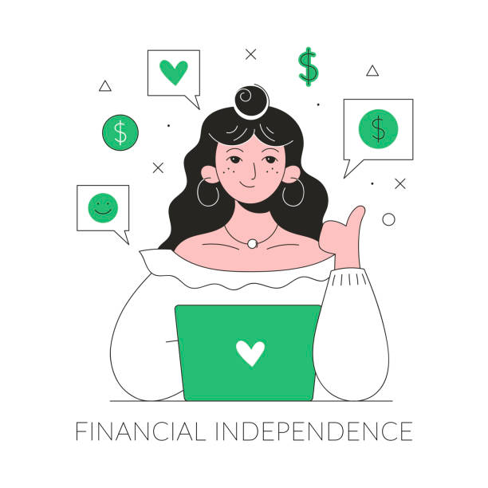
What is Financial Security to us?
From the perspective of a college student, new to the working world, we believe financial security falls into four categories:
-Health
-Housing/Investments
-Loans/Debts
-Budgeting

Slide 6

You’re probably wondering:
What does FemFinance have to do with women’s safety?
Here's how financial security and women's safety are interconnected:
Economic Abuse: When women lack financial independence, they may feel trapped in abusive relationships, compromising their physical and emotional safety.
Housing Insecurity: Financial instability can lead to housing insecurity or homelessness, which can expose women to unsafe living conditions, including the risk of physical and sexual violence on the streets or in temporary shelters.
Healthcare Access: Without financial security, women may struggle to afford necessary healthcare, including services related to reproductive health
Education: Financial limitations can hinder educational opportunities, which can affect women's future earning potential.

Slide 7




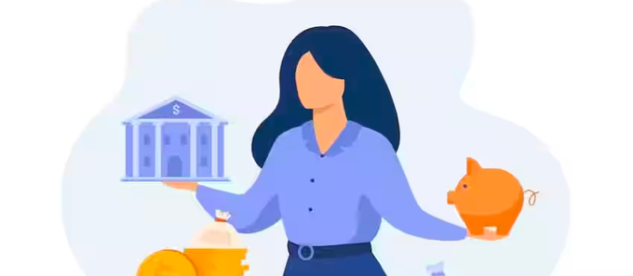

HEALTH
Health Insurance
Retirement
Affordability
Though it may seem far away for those new to the working world, retirement plans would be taught. Many new graduates are unaware of how to prepare for retirement, and what plans best suite them. The app would help decrease the unpreparedness and anxiety that surrounds retirement.
Resources for affordable healthcare would also be provided. If users need personalized options, they would have the opportunity to connect with professionals both virtually and in person.
This app would teach users how to properly select a suitable healthcare plan as well as finding jobs that offer great benefits.

Slide 8

HOUSING/INVESTMENTS
01
Wealth Building
The app will teach women how to mitigate different forms of investments such as:
index funds
stocks
bitcoin
etc.
02
Homeownership and Equity
Teach women how home ownership serves as a form of investment, and how to fully maximize their resources.
managing bills
all there is to know about property tax
mortgage knowledge
03
Income Streams
Show women to benefits of multiple income streams and how this is somewhat of a key factor for financial security.

Slide 9
Community Support:
Connect with other women graduates facing similar financial challenges. Share experiences and offer support to one another.
Career Development:
Access resources for career development, such as interview tips, networking strategies, and guidance on career advancement.
Financial Goal Setting:
Set, track, and achieve your financial goals, whether it's building an emergency fund, saving for a home, or starting a business.
Financial Workshops: Participate in online workshops led by financial experts, addressing common challenges women face in personal finance..
Financial Education:
Access a comprehensive library of resources and guides tailored to women's unique financial needs and concerns.
Budgeting and Expense Tracking:
Stay on top of your finances with easy-to-use budgeting tools and expense tracking features. Learn how to save and invest effectively.
Debt Management:
Understand and manage student loans, credit card debt, and other financial obligations.
Investment Insights:
Learn about smart investment strategies, understand stocks, bonds, and other investment vehicles.

Slide 10
Where will we get or information for these courses
Other credible sources we would use
Collaboration with Financial Educators
Financial News Outlets
Books and Publications
Nonprofit Organizations
*Online Libraries: Online libraries and databases, such as Google Scholar and JSTOR
Government Websites: Many government agencies provide resources on financial literacy and related topics.
Financial Institutions/Organizations: The website could partner with different organizations, and use their resources to teach users.
Financial Experts and Advisors: Contact financial experts, certified financial planners, and advisors who can provide expertise and authoritative information.
How would we compensate these people?
Promotion and Exposure
Content Licensing
Revenue Sharing
In-App Advertising

Slide 11
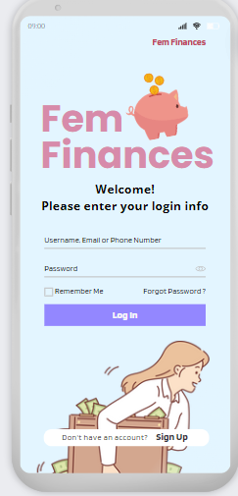
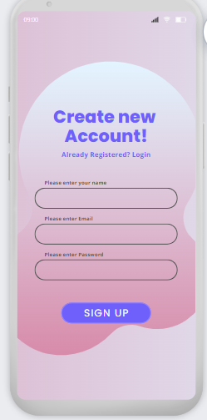
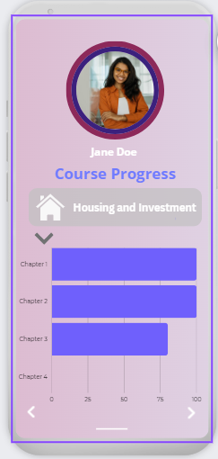
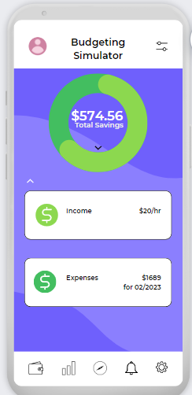
Our DEMO

Slide 12
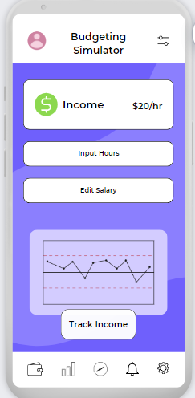
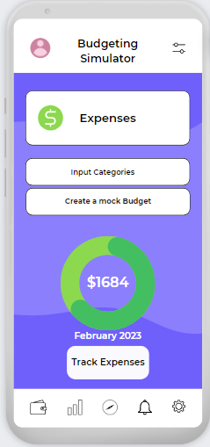
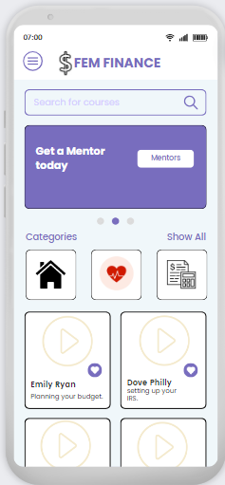
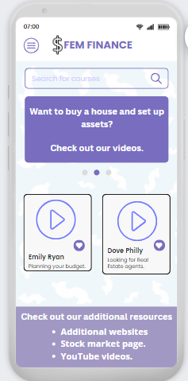
Our DEMO

Slide 13
Empower women graduates with essential financial knowledge and skills.
provide a user-friendly, secure, and confidential platform.
Our app will...
regularly update content and resources to keep you informed and engaged.
provide a safe space to discuss and address gender-specific financial issues.
provide a community that fosters connections and support among women graduates.

Slide 14
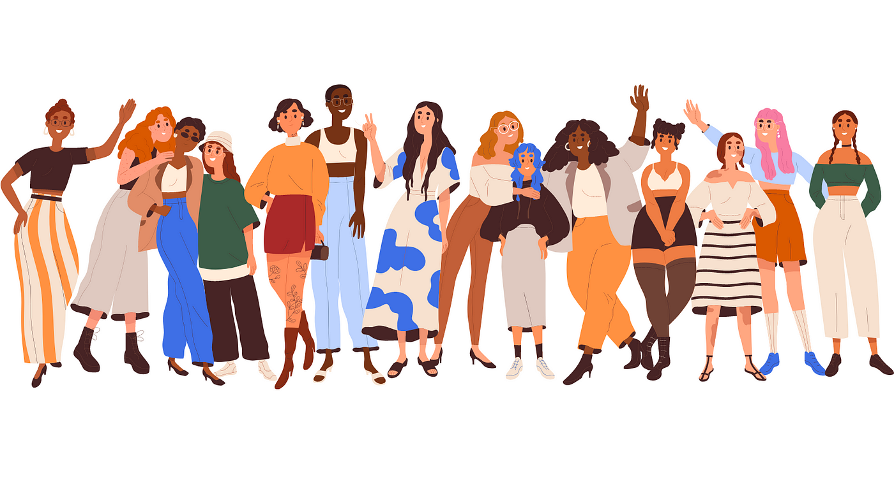
FemFinances
Empowering Women Graduates for Financial Success
Don't let financial worries hold you back from your aspirations. Download the "FemFinances" app today and join a community of women who are determined to take control of their financial future. Let's work together to secure your financial success!

